Slide 1

Ellisa Scott – Senior Advocate
Notes:
‘I would like to acknowledge and pay my respects to the traditional custodians of the land we are gathered on today –the Wurundjeri (goon-ditch-mara) People and pay my respects to their Elders past and present. I would also like to acknowledge other Elders and community members present here today.

Slide 2
IMHA: Background
Reforms to the Mental Health Act 2014 (Vic)
  Supported decision making mechanisms
  Mental Health Principles
  Independent, representational advocacy - a key mechanism
Notes:
How did IMHA come about? From Reforms to MH Act in 2014 which include the following:
provide the services to implement supported decision making mechanisms & working with regard to the MH Act principles
ensure people are supported to make, or participate in, decisions about their assessment, treatment and recovery.
working with the mental health sector to improve outcomes for consumers and help realise the objectives of the Act.
Independent- IMHA sits outside mental health services, hospitals and government so that there is no conflict of interest
Representational – representing the consumer voice, consumer led, consumer focussed

Slide 3
IMHA: Eligibility
Free service
All people on compulsory treatment orders
Graduated levels of service based on priority indicators
Notes:
Priority Clients- A&TSI, CALD, Dual Disability, Assistance with Communication, voluntary inpatients at risk of becoming compulsory, ECT -1st time, subject to restrictive interventions e.g. bodily restraint, seclusion, people in SECU, experiencing homeless
In early phase- significant outreach at inpatient facilities and community settings
Connecting with people who may not feel able/inclined to approach
Providing information via IMHA website and inquiry line to family members & carers – provide information to anyone who contacts IMHA
In the community, in-patient facilities and forensic facilities

Slide 4
IMHA: What do advocates assist with?
  IMHA advocates support and assist people who are receiving compulsory mental health treatment to make decisions and be involved in their mental health assessment, treatment and recovery

Slide 5

What is Supported Decision Making? (1)
Substitute
Decision
Making
Shared
Decision
Making
Supported
Decision
Making
-Making a decision for someone else
-Mental Health Act 1986
-Assumption that the person needs another person to make decisions for them
-Focus on ‘best interests’ (1)
-Decisions are made jointly with consumer and clinician
-Discussion and consideration given to the consumer’s preferences
-Focus on collaboration between consumer and clinicians (2)
-Places the person being supported in the front of the decision making process
-Mental Health Act 2014
-Emphasis on the ability of the person to make the decision, when supported appropriately
-Focus on what the person wants (1)
(1) Adapted from Australian Law Reform Commission 2013 https://www.alrc.gov.au/publications/supported-and-substitute-decision-making
(2) Adapted from The Medical Journal of Australia 2014 https://www.mja.com.au/journal/2014/201/1/shared-decision-making-what-do-clinicians-need-know-and-why-should-they-bother
Notes:
Note that Supported Decision Making is a very consumer driven style of providing support.
SUBSTITUTE:
Making a decision for someone else: e.g. psychiatrist
Assumption that someone needs another person to make a decision for them: if they made the decision themselves it would not be in their interests
Focus on best interests: people making decisions ‘to do good for the patient, the avoidance of harm and the protection of life’ (Hippocratic Oath)
___________________________________________________________________
SHARED:
Decisions are made jointly by consumer and clinician: come to the decision together, no primary decision maker
Discussion and consideration given to the consumer’s preferences: consumer’s preferences may be central to decision making process however so are the clinicians
Power dynamics should be considered: power dynamics may be present in decision making process, particularly if a consumer is on a CTO
__________________________________________________________________
SUPPORTED:
Places the person being supported in the front of the decision making process: they are the primary decision maker
Emphasis on ability of person to make the decision, when supported appropriately: strengths based approach, focus on what assistance person needs rather than deficits
Focus on what the person wants: rather than what others determine is in their best interests
Dignity of Risk, rights, and recovery principals inform this model

Slide 6
IMHA: Advocacy methods
Single issue/ immediate needs – Often over the phone, may not be advocate who attends the inpatient unit in the region.
Ongoing issues – Can be in person, over the phone, through email. (treating team meetings, referrals to other agencies, advocacy and coaching for self-advocacy).

Slide 7
IMHA: our advocacy model
Representational advocacy
Taking instructions from consumers
Consumer voice - Not best-interests
Supporting self advocacy by consumers
Information provided by clinicians/support people is shared with consumers
Notes:
Not best interest advocacy – take instructions from consumers
Support consumers to self advocate where possible
Provide representational advocacy where needed e.g. represent their views to clinicians
- Nothing about us, without us…

Slide 8
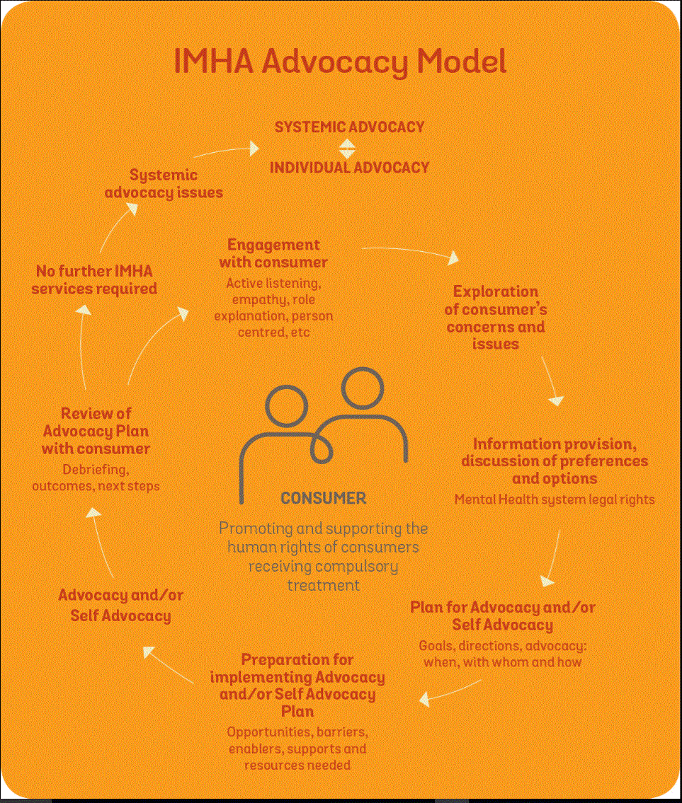
Notes:
Engage with consumer
Explore concerns/issues
Provide information/discuss options/preferences
Plan for advocacy/self advocacy
Preparation for implementing plan
Advocacy/self advocacy
Review of plan with consumer
**Feeds into systemic advocacy
**We also have systemic advocacy model

Slide 9
IMHA: What does this look like in practice?
  Information about the mental health system & consumers rights
  Participation in treatment decisions
  Advance Statements & Nominated Persons
  Referrals
  Coaching for Self Advocacy
  Advocacy
Notes:
Mental Health Act, mental health services, treatment orders and the Mental Health Tribunal process (not legal advice)
Assisting a client to self-advocate around the views and preferences regarding treatment e.g. medication, leave entitlements etc, and providing representational advocacy if needed
Explaining the role of advance statements/when they can be overridden and/or assisting someone in the process of preparing an Advance Statement.
Identifying relevant services (e.g. housing, family violence, employment, debt advice) and making referrals
Not an exhaustive list! Support consumers around many different issues related to mental health assessment, treatment and recovery

Slide 10
Speaking From Experience
  Consumer Advisory Group
  10 consumers with lived experience of the mental health system, diverse experiences (2 have used IMHA services)
  Ensures consumer perspectives are central to our services
  Monthly meetings
  Purpose - Strengthen/support consumer leadership & engagement
Notes:
Speaking from Experience (SFE) envisions a community where people who engage with mental health services are free from harm, are supported to be actively involved in decision making and are respected and heard.
SFE envisions that human rights are upheld; that people are never forced to engage with mental health services; that people have access to timely legal representation; and are provided with the services they need to keep them safe.
Works within a HR framework
Views and advice help shape and inform VLA approach and decisions
Worked closely with IMHA to develop consumer Self Advocacy resources
SFE member on each interview panel – we have now had a member who utilised IMHA on an interview panel!
EOI to people who have used IMHA services, hope to increase this number in future as the program has been around for longer
Purpose –
Develops priorities for service improvements and plans to strengthen and support consumer leadership and engagement in partnership with the senior consumer consultant
Scopes the need and feasibility of a consumer workforce
Provide leadership into the development of staff training and education.

Slide 11
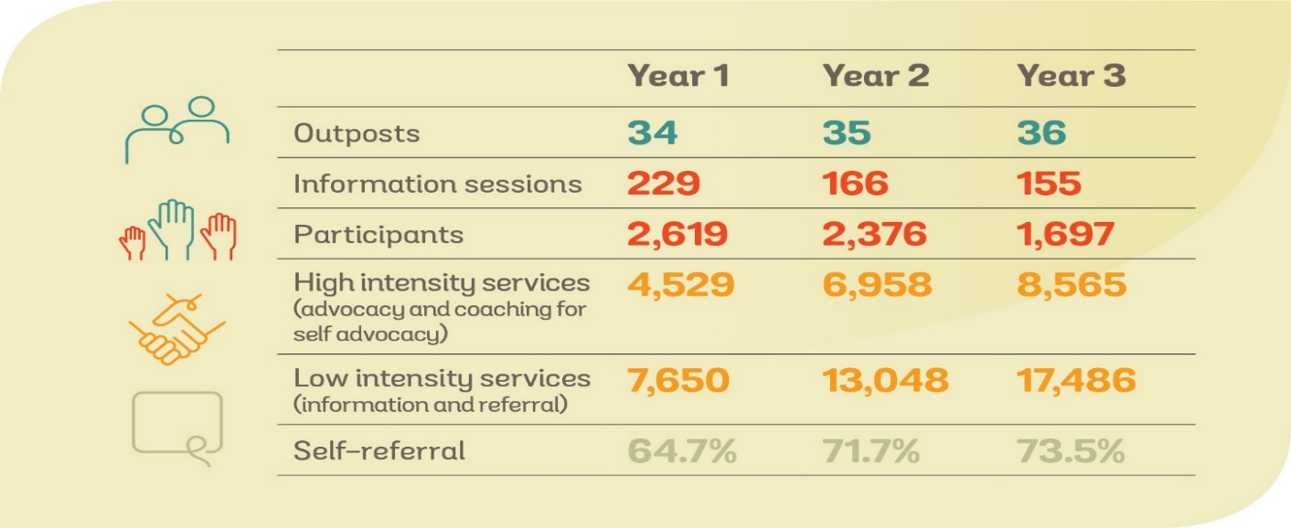
Our First Three Years of Service
Notes:
Majority of referrals are self referrals, through our intake line or at outposts
Shows that we have a consumer focus – consumers access us by choice, not by being referred by other services on their behalf
2018 saw increasing demand for a range of advocacy services

Slide 12
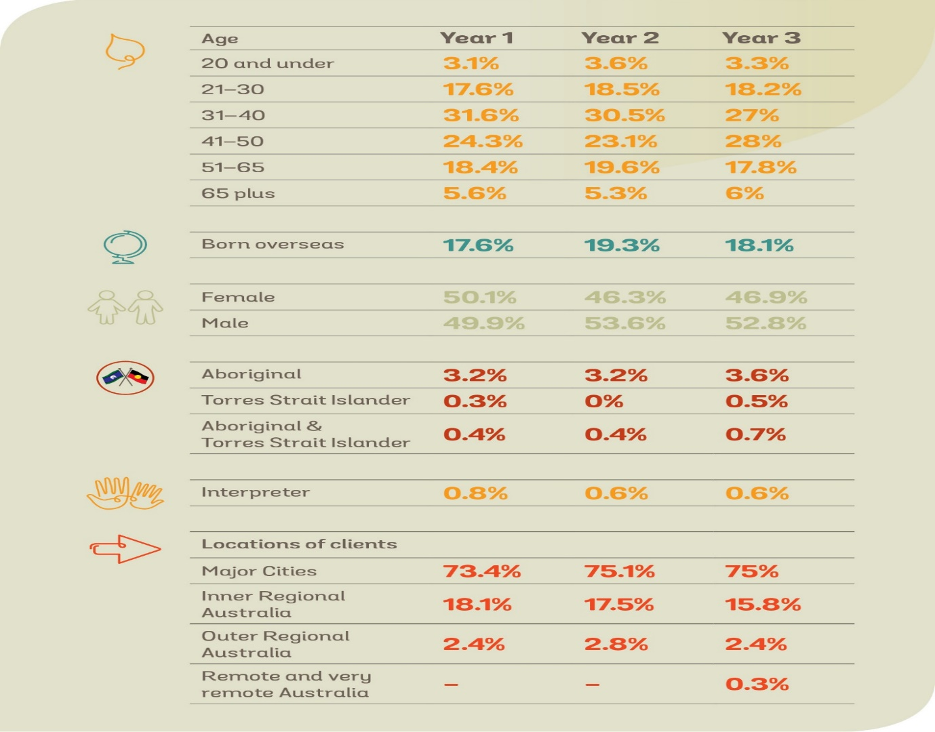
Our First Three Years of Service, cont.

Slide 13
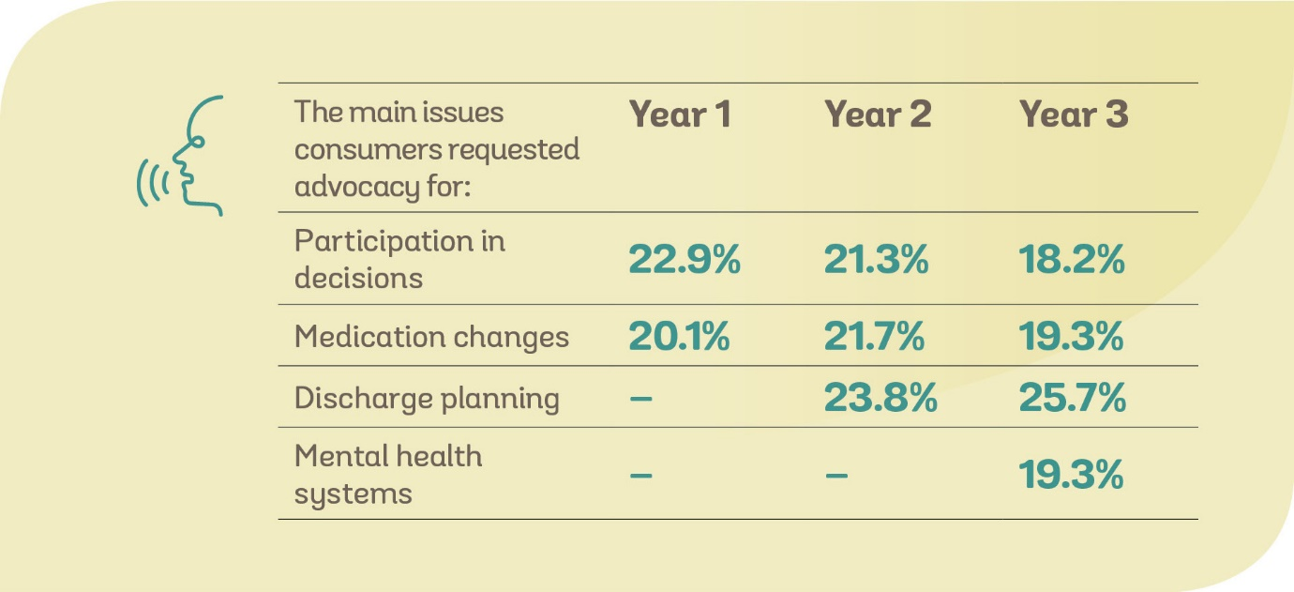
Our First Three Years of Service, cont.

Slide 14
Our First Three Years of Service - Themes
Access to consumers by advocates and Communication restrictions
  Restrictions on use of mobile phones
  Lack of privacy in communal areas (patient phones)
  Difficulty with staff assisting consumers
Safety
  Use of force by security guards, physical/emotional impact
  DHHS Sexual Safety & Family Violence policy not followed
Supported Decision Making
  SDM mechanisms are not integrated into MH service practice

Slide 15
Our First Three Years of Service – Themes, cont.
Rights
  Not being advised on an order, nor how meet criteria
  Voluntary – coercive practices, for example regarding leave
  No provision of information about treatment plans, told would be made compulsory if leave requested
Leave
  Standard approaches to leave, not considering individual needs
  Leave rules not explained, punitive responses when rules are breached
  Limited access to escorted leave due to staff shortages

Slide 16
Issues with application of MHA relating to AOD
  MHA potentially utilised to prevent access to AOD
  Limited availability of supports for AOD issues in acute units
  Limited availability of non-medication related support in acute units (psychosocial)
  Lack of AOD peer workers in acute units
  Punitive approaches to drug use (leave cancellation, restrictive interventions)
Notes:
Lucy’s notes –
Concerns about detention under the MHA being used to prevent access to AOD rather than focussed on MH per se. For example, a consumer I was working with in Orygen recently raised with me that he would prefer to be in a drug rehabilitation facility near Sunshine as he felt his issues were related to drug use rather than mental health, however it was quite a process to get admitted to drug rehabilitation facility given he had now been detained for MH.
Limited availability of supports for AOD issues in mental health units beyond once/week or less regular visits by AOD workers, particularly as some people might be experiencing withdrawal and AOD use not specifically related to MH but to broader life circumstances
Limited availability of non-medication related support in acute units for psychosocial issues which might be impacting/related to AOD use
While there are mental health peer workers in many units, not aware of AOD peer workers in mental health units
Some punitive approaches in acute environments to drug use (eg. cancelling leave or introducing restrictive interventions) with limited consideration of harm minimisation strategies – might lead consumers to conceal AOD use and create greater harm

Slide 17
Issues with application of MHA relating to AOD
  Limited consideration of harm minimisation strategies (different framework to mental health)
  MHA use as easier than AOD legislation
  Limited access to AOD services (limited services, waiting lists, barriers for people with MH issues)
  Tendency to respond to ‘issue’ or ‘label’ rather than the whole person, siloed response
Notes:
Helen’s notes -
The other one is use of the MH Act as it is easier to utilise that than AOD legislation.
Concerns that Mental health system does not have the resources to adequately respond to AD issues,
frameworks different – harm minimisation in AOD,
system access problems – limited rehabilitation services and waiting lists for detox services and barrier to people with MH issues accessing AOD services – vice versa –
silos that don’t respond to the individual needs – wrapping around and responding to the person rather than a label.

Slide 18
IMHA :Thinking about making a referral?
Is the person:
on a compulsory treatment order?
needing advocacy around an issue to do with their mental health assessment, treatment and recovery?
needing issue-specific, time limited advocacy – not ongoing support?

Slide 19



IMHA: what we look like
Melbourne
Manager & Admin Officer
Bendigo
Consumer Consultant
Geelong
Dandenong
Notes:
Non-legal service, staffed by people from advocacy, consumer, social work, and mental health backgrounds
Distinct brand identity and website from VLA
4 Senior : Emma Wilcox-Davies (Melbourne CBD); Liz Carr (Bendigo); Belinda Brady (Geelong); Ellisa Scott (Dandenong)
11 advocates, 4 in Dandenong, 2 Bendigo, 1 Geelong & 4 in Melbourne CBD
Meetings -all 18 designated Mental Health services across Victoria with senior management
Dedicated consumer consultant role, working with the program manager to ensure service is informed by consumer expertise
Fixed term project worker – self advocacy focus

Slide 20
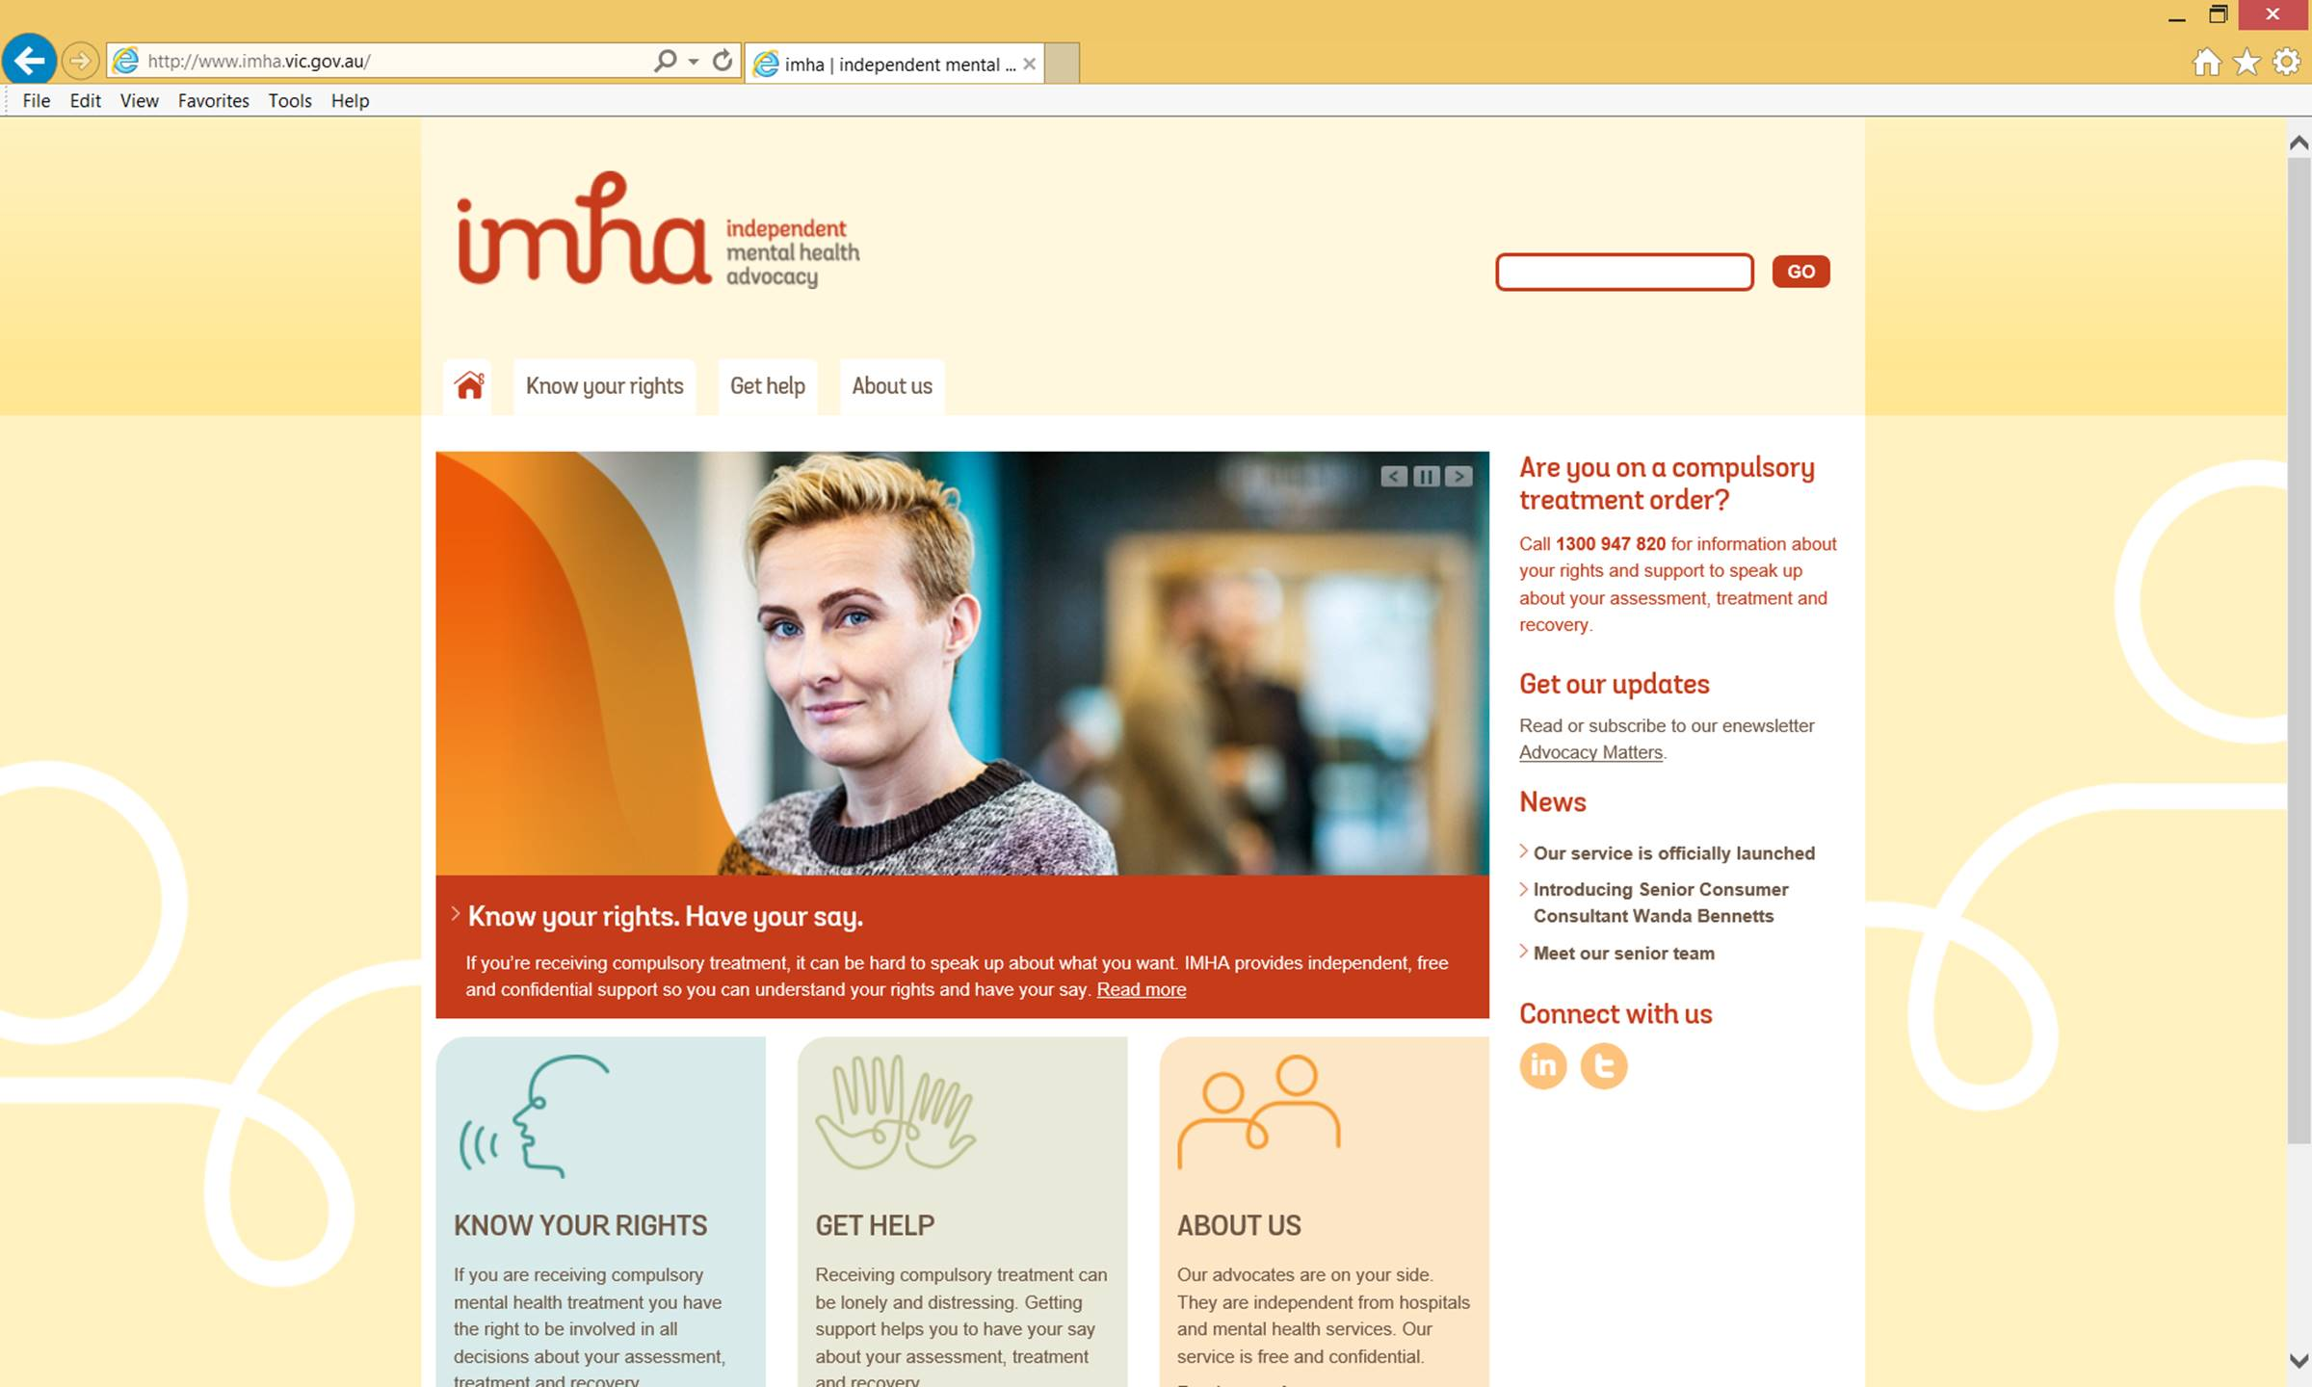
IMHA referrals
IMHA phone line on 1300 947 820
(9.30am - 4.30pm, Monday to Friday)
www.imha.vic.gov.au
contact@imha.vic.gov.au
Notes:
Entry points include a phone line staffed by Advocates, outposts and a website
IMHA inquiry line staffed by an IMHA advocate – information provision open to all, consumers, service providers, carers and support people

